Slide 1
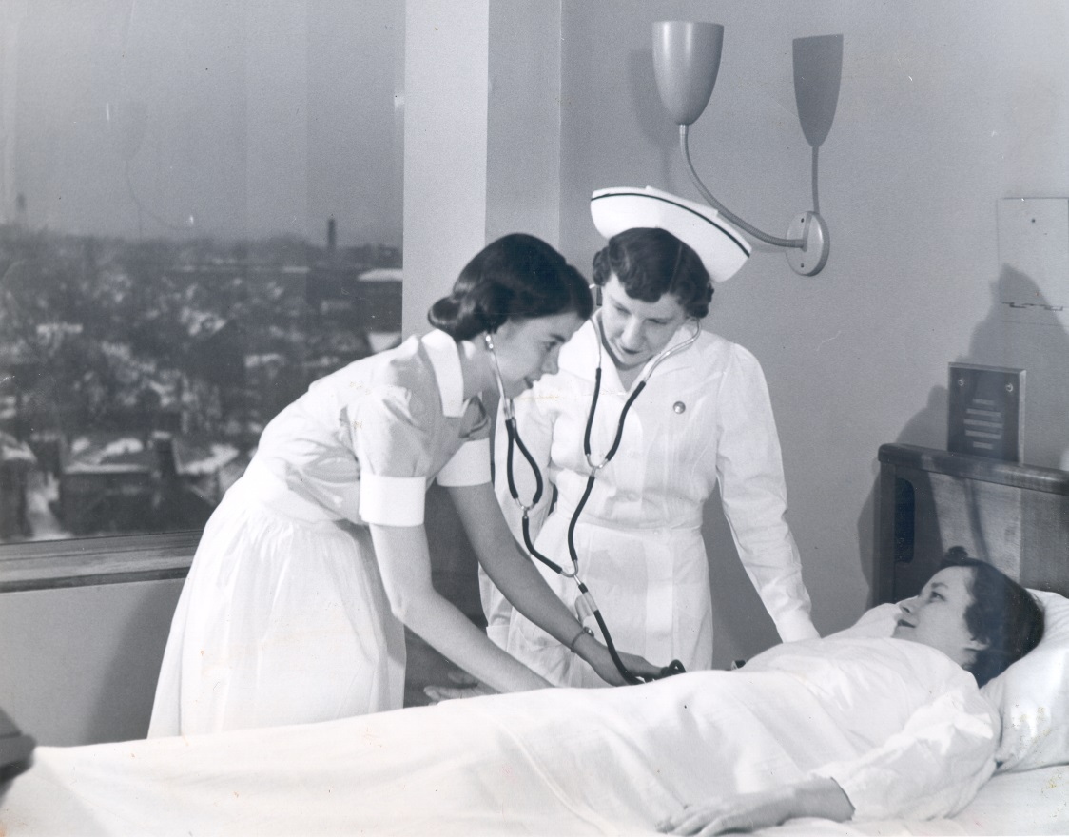
Nurses Taking History:
The MHC Nursing Oral History Program
Judith Wiener, MA, MLIS
Associate Professor
Assistant Director for Collections and Outreach
The Ohio State University Health Sciences Library

Slide 2
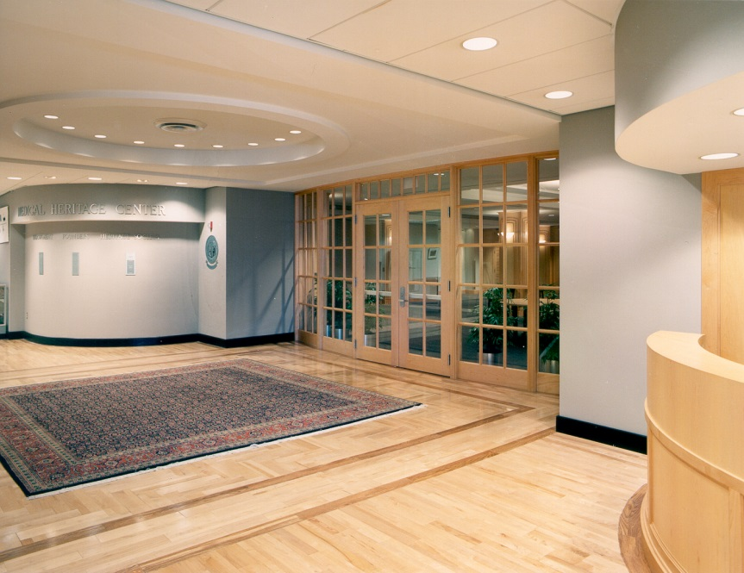
MHC Overview
Notes:
Founded in 1997 as a collaborative effort between the Columbus Medical Association Foundation and The Ohio State University.
The Center collects, preserves, and promotes the rich health sciences history of central Ohio as main collection focus.
Center houses a rare book, artifact, and archival collection areas. We have 14,000 rare books, 4,000 artifacts, and 131 archival collections.
Staff of 1.3 FTE (head curator and collection curator and two-three students).
reading room hours, reference by appointment, processing, exhibit, workshop and lecture programs. The center also supports a scholar-in-residence program.
Center is primarily supported through development accounts and endowments with some general programming and office support from the library organization.
The center administration is through the library but the center also through two advisory groups comprised of university and community members-the main MHC advisory committee board and the MHC Friends of Nursing History Steering committee.
history, budget, staffing, programming, budget

Slide 3
Friends of Nursing History Program
Notes:
The program was started in 2005 as a way to increase nursing history collections, support annual nursing programming, and begin collection oral histories
A steering committee was formed to guide the goals-Nurses interested in history and the head of local and state nursing associations we asked to join to support and promote the program. A development fund was established to support this work.
Thus far, 8 nursing archival collections, 9 nursing history lecture programs, and 39 oral histories have been developed through the program and steering committee work.
Work was recognized in 2011 as an outstanding award for nursing organizations by the ONA.

Slide 4
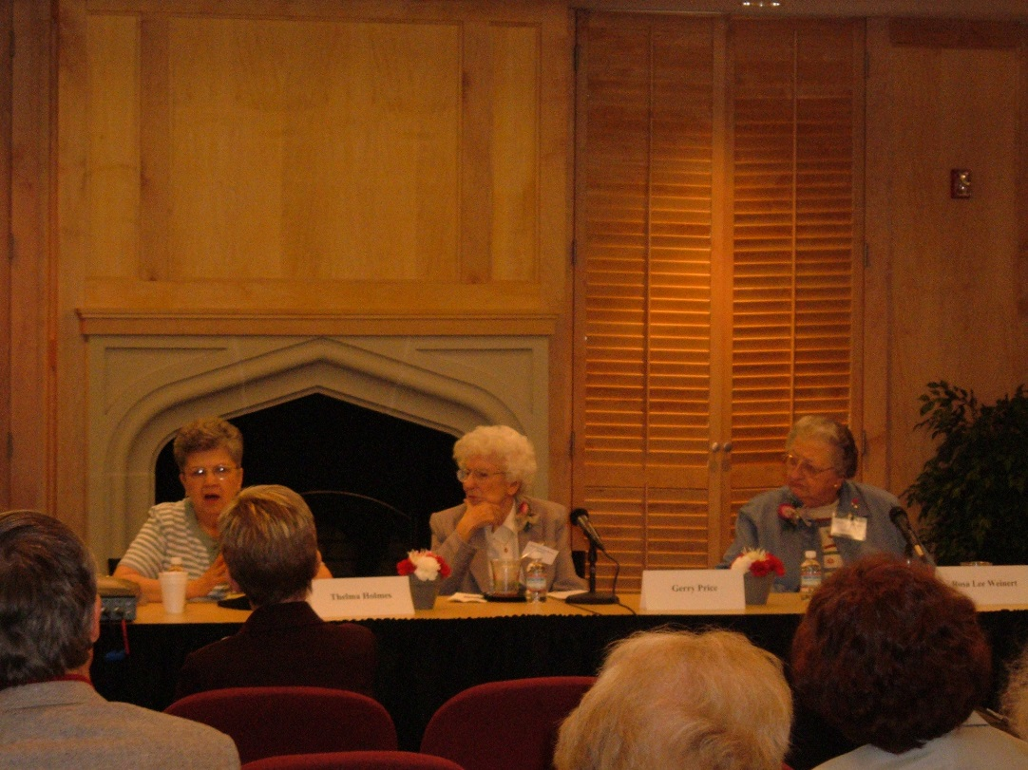
Local Nursing History Oral Histories
Notes:
The first oral history was conducted in 2000
Since that time, 39 oral histories have been created by the program.
Why select nurses to conduct interviews?
Nursing interviewees are asked to add materials to the collection-archival and personal. Includes a CV.
Some collections have more of this type of materials then others.
Average cost
MHC owns equipment-camera with tripod
Tapes duplicated in library’s event technology department.
Currently, we do not transcribe the tapes but a description, completed by the interviewer is completed post-interview to add to the finding aid for the collection.

Slide 5
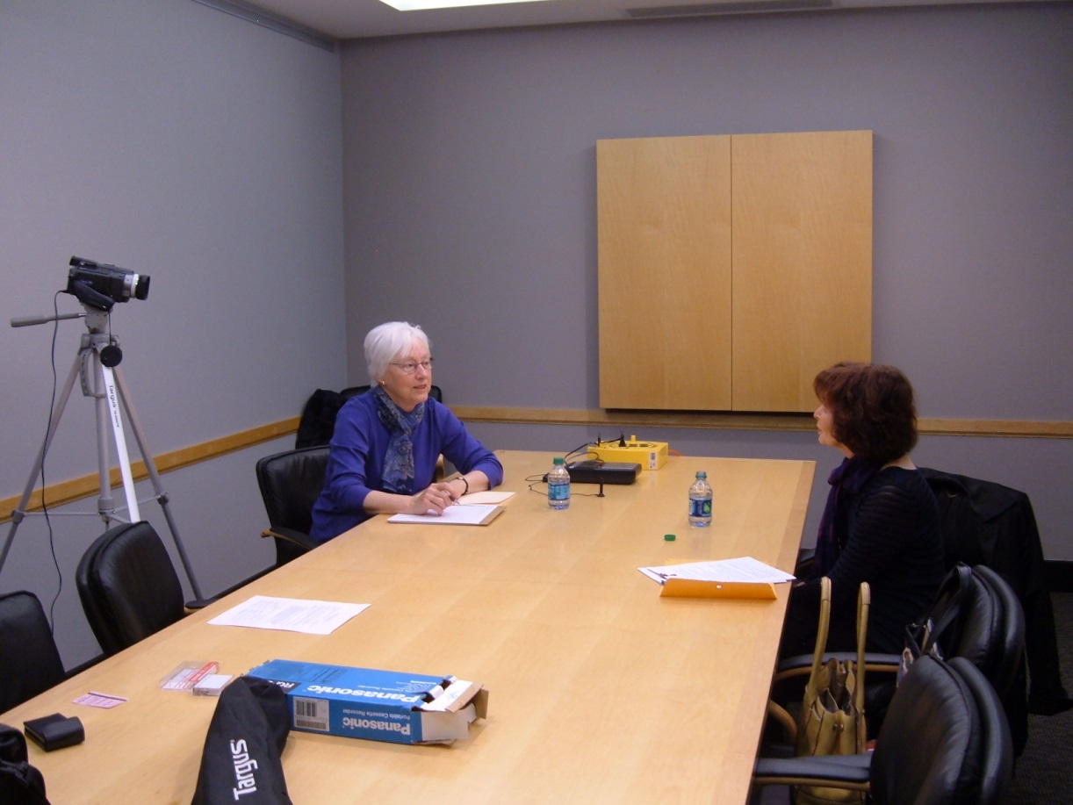
Oral History Process
http:// hsl.osu.edu
Notes:
1.) Interviewees discussed and identified at Friends of Nursing History Steering committee meeting. Person to conduct interview is selected.
2.) Interview is contacted to determine interest. Interview location and date are set (usually at the MHC). Packet containing interview process information, sample questions, and FAQ is sent prior to interviewee to help them become familiar with the process and begin to think about questions/organize thoughts. Preliminary questions also serve to standardize interviews in some manner. Sample of oral history agreement also sent, which outlines rights and responsibilities. People also are asked to think about any archival materials they wish to donate to support their oral history.
3.) Interview is conducted. MHC sets up equipment, provides refreshments/water, provides or travels to site. Nurse volunteer conducts interview. Interview release signed on the day of the interview.
4.) Tapes sent to Event Technologies department for transfer to DVD. Original recording and access copies for the MHC and one DVD is given to the interviewee. Family often love this and is a major incentive for people to provide oral history.
5.) Follow-up thank you sent by interviewee with reminder of archival materials that could be used to supplement collection-this can be specific if items were named during the interview or general.
6.) DVD sent to the interviewee with a thank you from the center. Person placed on MHC mailing list for future contact. Often ends up being a long-term relationship/supporter.
7.) Abstract or summary of the interview is completed by the interviewer. Collection including the abstract and any archival materials are added to the MHC archives and finding aid.

Slide 6
Collection Development and Use
Notes:
Currently, finding aid of interviews are including on our website and in the Ohio Link Finding Aid repository.
Open and Used by researchers in the reading room, in preparation for our nursing programming.
Contributors asked to contribute additional names/people to interview.
Interviews often become ardent supports of the MHC and lead us to further supporters.

Slide 7
Plans for the future
Notes:
Future plans include:
Deposit of our interviews into the OSUL institutional repository knowledge bank,
transcriptions to add to summary,
expansion of program beyond nursing with volunteers from other backgrounds, such as optometry, medicine, dentistry
Targeting future interviewees to round out collections/ build up strengths in underrepresented areas.

Slide 8
Any Questions?
Judith Wiener
judith.wiener@osumc.edu
Notes:
Add nursing image of some sort
Questions will be held to the end of the panel but this is my e-mail address if you would like to receive copies of any of the information I listed in my presentation.

